Slide 1
GameDev + AI @ Xsolla
Game Engines in the Age of AI-Based Development
Current Overview
Unity
Godot
Web engines
(Unreal not covered)
Notes:
Open by naming the boundary up front: this is a workflow talk about how AI changes engine selection criteria, not an engine fan war. Say plainly that Unreal is out of scope because I have no direct hands-on experience with it. Set expectations: 35 minutes, then discussion.

Slide 2
Ohad Barzilay
Hedonia
Chief Product Officer
Ilyon Dynamics
VP Product & Data
Rovio
Lead Designer & Producer, Pet Monsters
Mytopia
GM → COO + Chief Creative
Working on a personal CC / Codex Harness for developing commercial games (and making games with it).
Notes:
Quick personal intro. Establish credibility up front: 20+ years across mobile, casino, and games, most of it Unity-based, a GameIS founding member, roles spanning general management, product, and design — so this isn't a Godot partisan's take, it's someone comfortable in Unity questioning whether comfort is still the right criterion.

Slide 3

Hedonia
Mood Bloom
CPO, 2020–2025 · clinically validated at Mass General · 45% reduction in depressive symptoms
Notes:
Credential slide — most recent chapter of my career. Chief Product Officer at Hedonia, where we built Mood Bloom: a therapeutic mobile game clinically validated in a randomized controlled trial at Massachusetts General Hospital, showing roughly a 45% reduction in depressive symptoms. Five years of my life, a real Unity production, and the reason I care this much about what actually makes an engine workable in production.

Slide 4
AI Adoption
AI coding is now mainstream
58%
59%
use AI tools daily
use AI agents at work
37%
63%
use AI agents daily
rarely or never let agents run fully autonomously
Stack Overflow Pulse Surveys, Feb & Apr 2026 (~900–1,100 respondents)
Notes:
Ground the talk in real numbers before making any argument about games. Across software development broadly: 58% use AI tools daily, 59% use AI agents at all, but only 37% use agents daily, and 63% still rarely or never let an agent run fully autonomously. The gap between 'use AI' and 'trust AI to drive' is the story.

Slide 5
AI Adoption
Adoption in GameDev
29%
36%
of game developers use generative AI
of all game-industry professionals use it
30%
58%
adoption directly at game studios
adoption in publishing, support, marketing & PR
Game Developer Collective / Omdia & GDC 2026 State of the Game Industry (2,300+ respondents) — 29% figure is explicitly early-2026 data
Notes:
Now narrow to games specifically. Adoption is lower than software overall and split sharply by role: only ~30% at studios directly, but 58% in publishing, support, marketing, and PR. Flag that the GDC 29% figure is explicitly early-2026 data and the report doesn't disclose exact fieldwork dates.

Slide 6
AI Adoption
Mostly brainstorming. Coding is catching up.
Research & brainstorming
81%
Coding assistance
47%
Prototyping
35%
Asset generation
19%
Among game-industry professionals already using generative AI · GDC 2026 State of the Game Industry (2,300+ respondents)
Notes:
Among game-industry professionals who already use generative AI, most of it is still research and brainstorming, not code. Coding assistance is real but well behind — this sets up the rest of the talk, which is specifically about that coding-assistance slice.

Slide 7
HOW WE USED TO CHOOSE A GAME ENGINE
How we choose a game engine
Target platforms
Proficiency of existing team
Maturity of dev & art tools
Ecosystem (SDKs, services, plugins)
Licensing & cost
Commercial support
Community support

Slide 8
How we choose a game engine
HUMANS
Target platforms
Proficiency of existing team
Maturity of dev & art tools
Ecosystem (SDKs, services, plugins)
Licensing & cost
Commercial support
Community support
We chose the engine that best supported the human team and the final product.
Notes:
Side-by-side pivot slide. Left: the traditional human-era criteria — we chose the engine that best supported the human team and the final product. Right: development is now also done by agents, so a parallel set of criteria applies. This is the pivot the rest of the talk builds on.

Slide 9
Since AI does a growing share of the coding, the engine should fit the AI — not the people.
Notes:
The one-line reframe the whole talk hangs on. Read it slowly, then move into the loop.

Slide 10
How we choose a game engine
HUMANS
AGENTS
Can it understand the project?
Target platforms
Can it safely change scenes & assets?
Proficiency of existing team
Can it run the game without a human?
Maturity of dev & art tools
Can it observe the result?
Ecosystem (SDKs, services, plugins)
Can it test & validate its own work?
Licensing & cost
How fast can it repeat the loop?
Commercial support
Can multiple agents work in parallel?
Community support
Can it legally access the engine & docs?
We chose the engine that best supported the human team and the final product.
The engine is no longer operated only by humans. It is also operated by agents.
Notes:
Side-by-side pivot slide. Left: the traditional human-era criteria — we chose the engine that best supported the human team and the final product. Right: development is now also done by agents, so a parallel set of criteria applies. This is the pivot the rest of the talk builds on.

Slide 11
THE THREE OPTIONS DISCUSSED
UNITY
GODOT
WEB ENGINES
Mature commercial engine Large ecosystem Strong mobile & platform support Editor-centric workflow
Open-source Lightweight Text-oriented project structure Smaller commercial ecosystem
Three.js (3D), Phaser (2D) Code-first, browser-native Excellent for prototypes Instant distribution
Not covering Unreal — not enough hands-on experience with its current AI workflow.
Notes:
Quick overview of the three engines discussed, plus the Unreal disclaimer.

Slide 12
THE LOOP THAT ACTUALLY MATTERS
The agentic development loop
Human–AI feedback
→
Plan
→
Generate files
→
Run in engine
↑
repeat
↓
Fix bugs & params
←
Errors
←
Test
←
Every stage has to be visible, controllable, deterministic, and cheap — code generation is only one node.
Notes:
Walk the loop once, then make the point: every stage here has to be visible, controllable, deterministic, and cheap for an agent — code generation is only one node. The loop closes back on itself dozens or hundreds of times per task.

Slide 13
UNITY
STRENGTHS
WEAKNESSES
Mature production environment Massive ecosystem & Asset Store Excellent mobile SDK coverage Strong console & platform support Large developer pool C# & established architecture Commercial support available
Unity is an editor-state engine Unity’s serialized formats are fragile Asset references create risk (.meta) The editor still sits in the middle * Unity is slower and heavier
Notes:
Unity's classic strengths and weaknesses, before bringing agents into the picture.

Slide 14
GODOT
STRENGTHS
WEAKNESSES
Most project files are readable text Agents can modify scenes more safely Fast startup & iteration Straightforward CLI & headless use Cheap to run several instances Open engine source & docs Less dependency on the graphical Editor
Models often mix Godot 3/4 syntax Less training material & proven patterns Smaller MCP & tooling ecosystem Weaker mobile ads/IAP/analytics integration Console support still via third parties Serious engine problems may need your own engineering
Notes:
Godot's text-first structure makes it unusually agent-friendly, though model training data lags and mobile monetization stays weak.

Slide 15
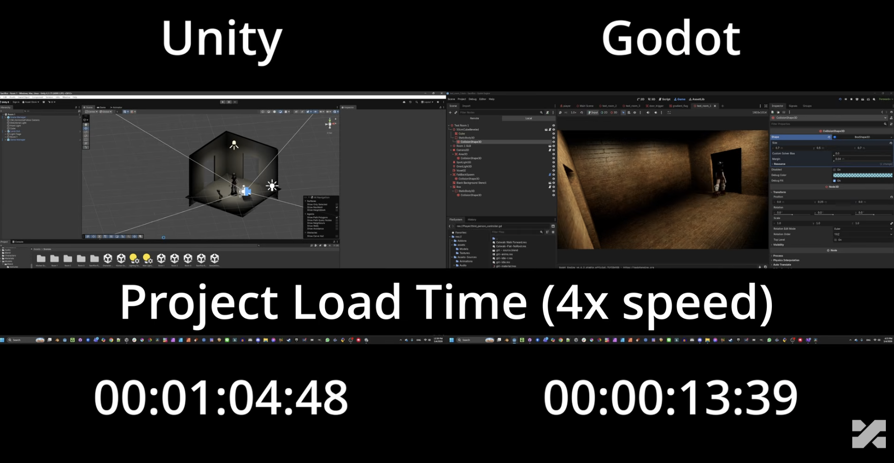
CASE STUDY · SAME GAME, BOTH ENGINES
Project load — 1:04 vs 0:13
Paid on every cold start.
Notes:
Same game, built twice — once in Unity, once in Godot — by one developer, measured side by side. Project load: 1:04 vs 0:13, shown here at 4x speed. Credit: 'I Made The Same Game in Unity and Godot, Which Engine is Better?'

Slide 16
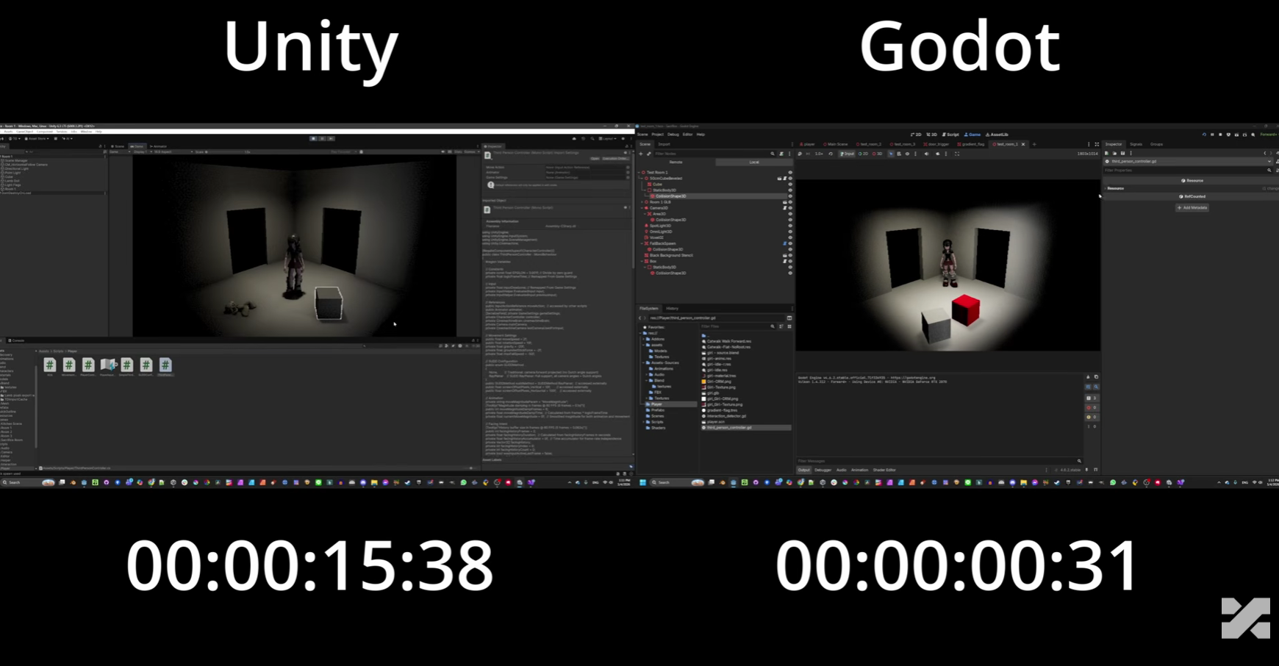
CASE STUDY · OPENING A SCRIPT
Opening a script — 15.4s vs 0.31s
A 50x gap on the most repeated action in the loop.
Notes:
Opening a single script: 15.4 seconds in Unity, 0.31 seconds in Godot. Annoying for a human; decisive for an agent that does this hundreds of times per task. Credit: 'I Made The Same Game in Unity and Godot, Which Engine is Better?'

Slide 17
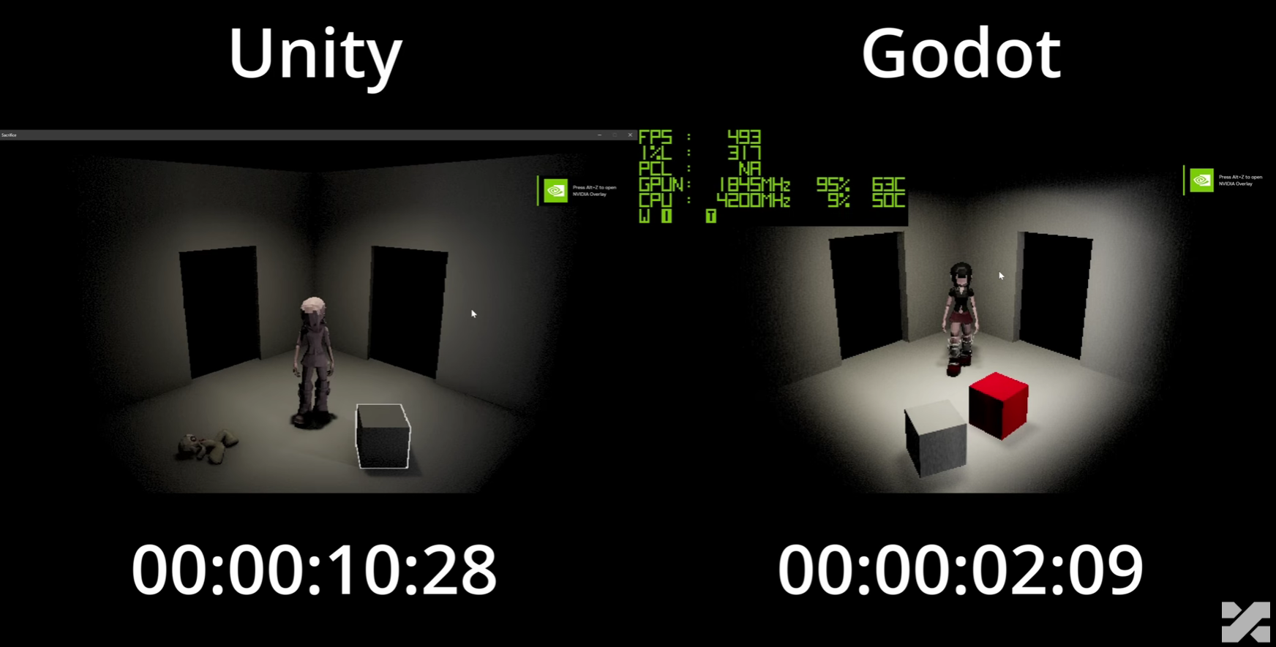
CASE STUDY · LAUNCHING THE BUILD
Launching the build — 10.3s vs 2.1s
Multiplied by every test the agent runs.
Notes:
Launching the built game: 10.3s vs 2.1s — a multiplier on every single agent test cycle. Credit: 'I Made The Same Game in Unity and Godot, Which Engine is Better?'

Slide 18
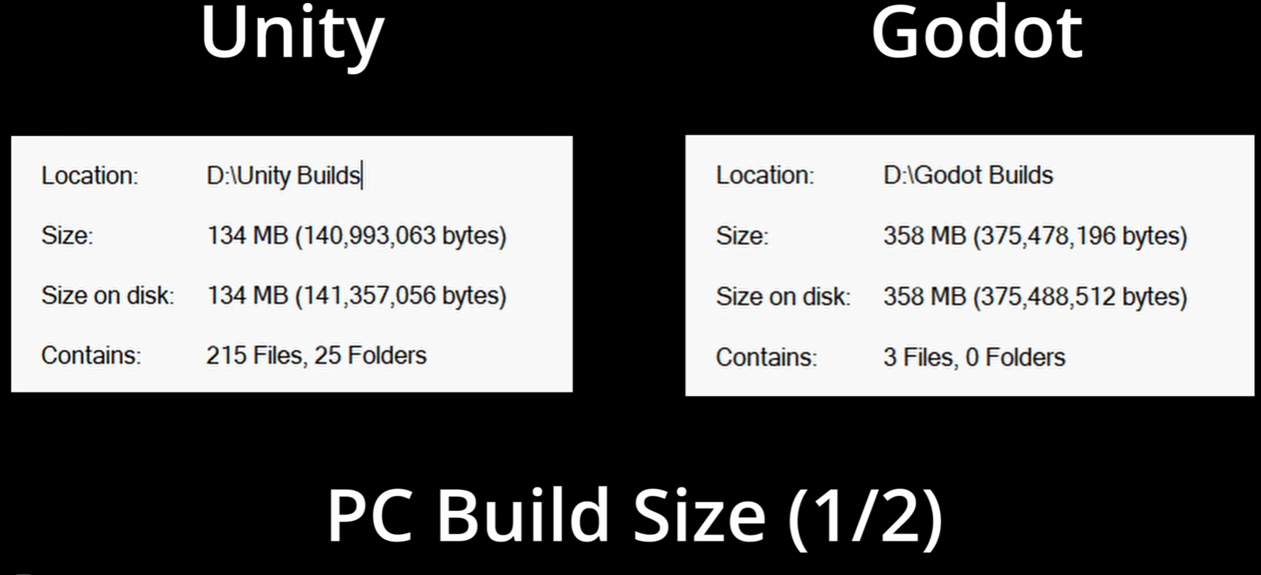
CASE STUDY · PC BUILD SIZE, DEFAULT EXPORT
Default export — 134MB vs 358MB
Godot loses badly on defaults.
Notes:
The honest counterpoint. Godot's default PC export came out nearly three times larger than Unity's — 358MB vs 134MB. Credit: 'I Made The Same Game in Unity and Godot, Which Engine is Better?'

Slide 19
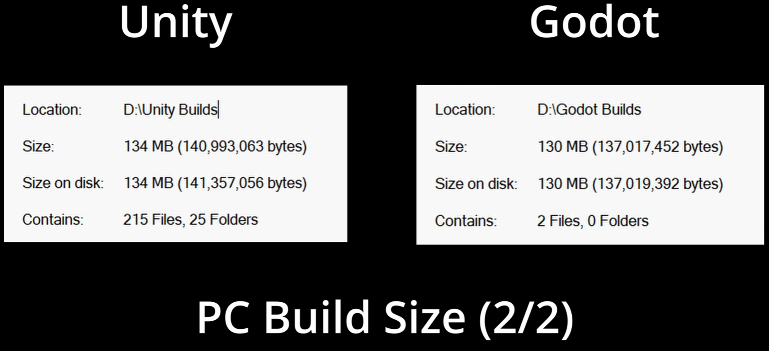
CASE STUDY · PC BUILD SIZE, CONFIGURED EXPORT
Configured export — 134MB vs 130MB
Godot iterates faster — and is less forgiving of defaults.
Notes:
Once the export was configured properly, Godot landed at 130MB — slightly under Unity. Faster to iterate, less forgiving of defaults. Credit: 'I Made The Same Game in Unity and Godot, Which Engine is Better?'

Slide 20
WEB ENGINES
STRENGTHS
WEAKNESSES
Almost everything is plain text Models know JS/TS/HTML/CSS extremely well Browser automation is easy Screenshots & runtime inspection are easy Very fast, cheap parallel iteration Instant deployment for feedback
WEB ONLY (even mobile) Agents can create messy architectures fast Still weak for native monetization/SDKs Browser success ≠ commercial product Moving to Unity/Godot may need a partial rewrite
Notes:
Web engines fit coding agents unusually well — almost everything is plain text agents already know well. Weakness remains commercial: moving a prototype to Unity/Godot may need a partial rewrite.

Slide 21
THE PROOF IN THE WILD
An explosion of AI-made web games
1,000+
entries in a single web game jam — many visually impressive, built on text-based, agent-friendly stacks like Three.js and Phaser.
Notes:
Concrete proof the web-engine loop works: a single jam pulling in a thousand-plus entries built on text-based, agent-friendly stacks.

Slide 22
WHAT CHANGED · THE CORRECTION
A colleague pushed back — correctly
HIS CORRECTION
HIS SETUP
Unity does work headlessly Multiple Unity processes can run in parallel Each needs its own project directory/worktree Large projects should keep imports warm Custom exporters can summarize assets for the LLM
Five persistent project copies Powerful MacBook + two additional machines SSH access Windows & macOS builds
This proves Unity can support parallel AI development — not that the workflow is lightweight or typical.
Notes:
Use a friend's criticism directly: Unity does work headlessly, in parallel, given separate worktrees and warm caches. Show his setup: five persistent project copies, a powerful MacBook, two additional machines, SSH access, Windows and macOS builds. He has deep Unity experience but hasn't tried Godot or other engines — useful operational feedback, not an engine comparison.

Slide 23
WHAT IS A "WARM" UNITY WORKTREE?
COLD PROJECT COPY
WARM PROJECT COPY
1. Create clone/worktree 2. Open Unity 3. Unity generates Library 4. Thousands of assets import 5. Startup may take a long time
1. Keep the project directory 2. Keep its existing Library 3. Update the Git branch 4. Unity imports only changed assets 5. The agent starts much faster
A warm worktree is a persistent Git worktree/project copy whose Unity Library cache has already been generated.
Cost: SSD space · cache invalidation · maintaining multiple copies · machine/licence management · operational complexity
Notes:
Define a warm worktree precisely and walk cold vs warm setup steps, plus the operational costs — SSD space, cache invalidation, machine/licence management.

Slide 24
UNITY'S NEW ANSWER · RELEASED JULY 2026
Unity CLI
Manage & install Unity versions
Authenticate from the terminal
Build projects, run tests
Structured output for scripts & agents
Talks to a running Editor or Player
Custom project commands, CI & headless support
unity eval — runs C# inside a running Editor or Player, no recompile, no domain reload.
Notes:
Released July 2026. Walk what it does; highlight unity eval as the standout — executes C# in a running Editor/Player without a recompile or domain reload.

Slide 25
CLI VERSUS MCP
CLI
MCP
Normal terminal commands Human, script, CI or agent — all can use it Structured output, more flexible Lower protocol overhead Best for agents that already run shell commands
Standardized tools with defined params Easier for constrained AI clients Built-in tool discovery Can consume considerable model context Large tool lists may confuse the agent
Unity's own developers say direct Pipeline/CLI calls are generally faster and more flexible. MCP stays available for clients that depend on it.
Notes:
CLI: flexible, low overhead, good for agents that already run shell commands. MCP: standardized, easier for constrained clients, but can consume context with large tool lists. Unity's own devs say direct CLI/Pipeline calls are generally faster.

Slide 26
TWO WAYS TO DRIVE THE SAME ENGINE
Official Unity MCP vs. Ivan Murzak MCP
OFFICIAL
IVAN MURZAK
Requirement
Unity 6 + AI Assistant package
Unity 2022.3+
Ownership
Unity, official
Open-source, community
Toolset
Growing, still limited
71 tools, 46 prompts, 1 resource
Best today
Safest under new terms
Broader, longer field-tested
Ivan Murzak's MCP is still the more capable one in my workflow — but the official CLI may matter more long-term. Its authorization status is now dependent on Unity's policies, not "prohibited."
Notes:
Official Unity MCP: safest under the new terms, still early on tools. Ivan Murzak's: 71 tools, 46 prompts, 1 resource — broader today. Personal conclusion: Murzak's is still more capable day-to-day, but the official CLI may matter more long-term. Frame authorization status carefully — not 'prohibited', but now dependent on Unity's policies.

Slide 27
UNITY TERMS PROBLEM · SECTION 17.2 · UPDATED JUN 30, 2026
Engine choice now includes AI governance risk
No training/validating AI models on Unity Offerings without authorization
No automated ingestion of docs/APIs/Asset Store for training or competitive intel
Agents/LLMs/CLIs/MCP may interact only via Authorized Agentic Access
Gateway, agent, model, MCP client & server must all be authorized — Unity can revoke
The terms don't ban a human showing a doc page to an LLM — they restrict automated ingestion and broadly control agentic access. Not legal advice.
Notes:
Section 17.2, last updated June 30, 2026. Be precise: this restricts automated ingestion for training/knowledge-base replication and requires Authorized Agentic Access across the whole chain — it doesn't say a human can never show a doc page to an LLM. Not legal advice.

Slide 28
EVALUATE ENGINES ON FOUR SEPARATE AXES
UNITY
GODOT
WEB
Technical AI readiness
Improving rapidly
Strong
Very strong
Operational cost
High
Low
Low
Commercial & platform support
Strong
Weaker
Weak for native
Legal & governance openness
Controlled, uncertain
Open
Open, fragmented
Unity improved its technical answer while making its legal & governance answer more complicated.
Notes:
Bring it back together on the four-axes framework. Headline: Unity improved its technical answer while making its legal/governance answer more complicated.

Slide 29
WHICH ENGINE FOR WHICH PROJECT?
Fast prototype / playable experiment
Web
AI-first small/medium commercial game
Godot
Mobile F2P with ads/IAP/attribution/analytics
Unity, often still practical
Console game needing commercial support
Unity's clear advantage
Existing Unity project / experienced team
Don't migrate for AI alone — improve the workflow
Autonomous parallel development
Godot & Web easier by default; Unity needs more infrastructure
Notes:
Concrete recommendations by project type.

Slide 30
TAKEAWAY
Unity has Architecture issue to solve. Godot and Web has Ecosystem issue to solve. Unity is in a bigger problem going forward.
The best engine is no longer just the one humans can use — it's the one humans and agents can understand, operate, test, and recover safely.
OPEN QUESTIONS FOR DISCUSSION
Is Unity now as good as Godot for AI?
Is Ivan Murzak's MCP still safe to use?
Can worktrees share one Library folder?
Why not Unreal?
Notes:
Close on three takeaway lines, then open the floor. Suggested prompts if the room is quiet: is Unity now as good as Godot for AI? Is Ivan Murzak's MCP still safe to use? Can several worktrees share one Library folder? Why wasn't Unreal covered?

